Slide 1
Smile Project
By Corbin Hofmann and Chase Lang
Period 6

Slide 2
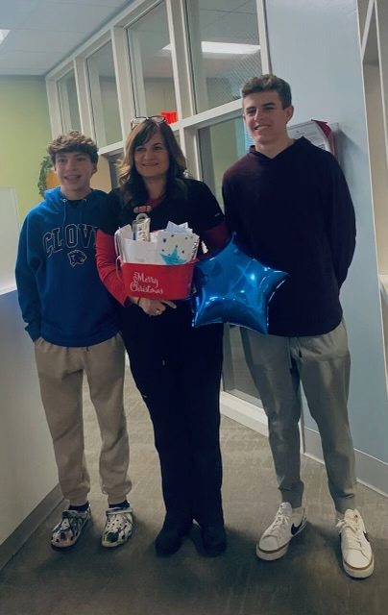
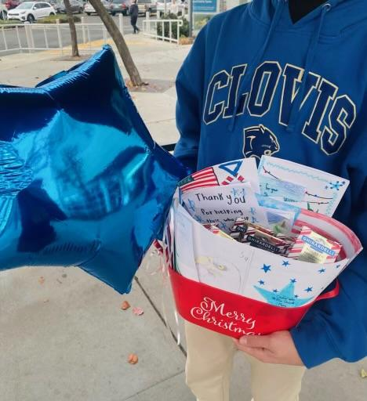
The Meaning of Our Project
What was the purpose of our project?
To help those that help others. We directed our Smile Project towards the Central Valley Blue Star Moms.
The Blue Star Moms are a volunteer organization made up of mothers of military service members with branches across the nation.
They tirelessly serve the community and give back to those who have served.
How was our project carried out?
In partnership with a sixth-grade class at Gettysburg Elementary, an assortment of notes were written.
Along with some chocolates, these were provided to the Blue Star Moms’ president, Lisa Bailey to distribute amongst her and her colleagues.
When we delivered these tokens of appreciation, we also asked her a couple of questions to gain a better understanding of her perspective on kindness and her service to the community and the military (more about this on Slide 3).

Slide 3
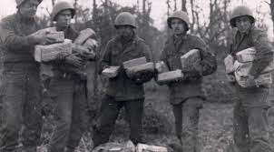
History of The Blue Star Moms
How did the Blue Star Moms Come to Be?
The Blue Star Moms Organization dates all the way back to 1942, during World War ll.
What started as a conversation between generals to raise morale evolved into a full-blown movement, some might say “the original Smile Project”, for troops
An advertisement was placed in the local newspaper in Flint, Michigan, for mothers to help make care packages; thousands of women showed up to what became the first gathering of the Blue Star Moms of America.
After this impressive showing, Congress took action and officially recognized the Blue Star Moms as an organized entity and branches were established across the country.

Slide 4
Perspective of a Blue Star Mom
Along with many expressions of gratitude, these are the questions we asked and the responses we documented:
What does Kindness mean to you?
What is the most important part of the
Blue Star Moms Organization?
“To me, kindness means treating others the same way I would want to be treated.”
“Troops are always our main focus. To uplift them is very important since they are in a much worse position than us. In other words, we’re the 12th man for the military, helping from home like fans help from the stands.”
What is your favorite part of being a Blue Star Mom?
“Receiving the pictures back from the military from all over the world with their care packages the Blue Star Moms have sent them.”

Slide 5
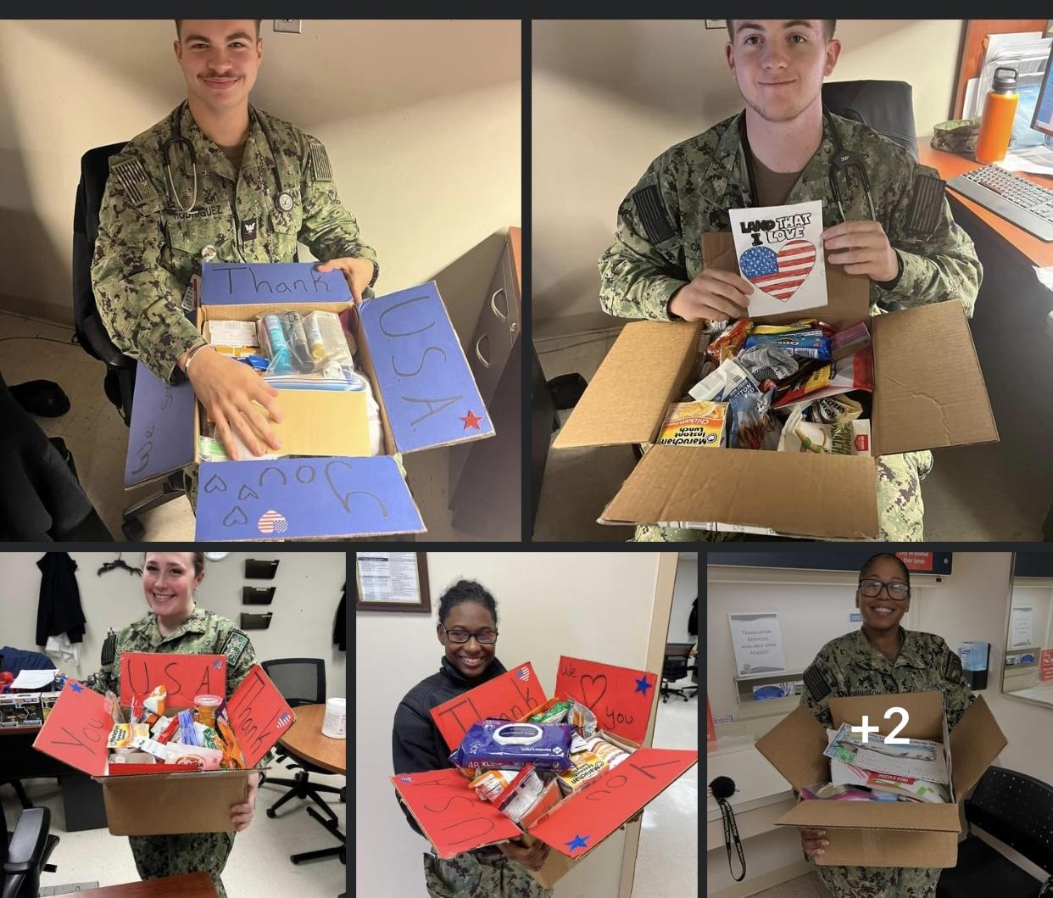
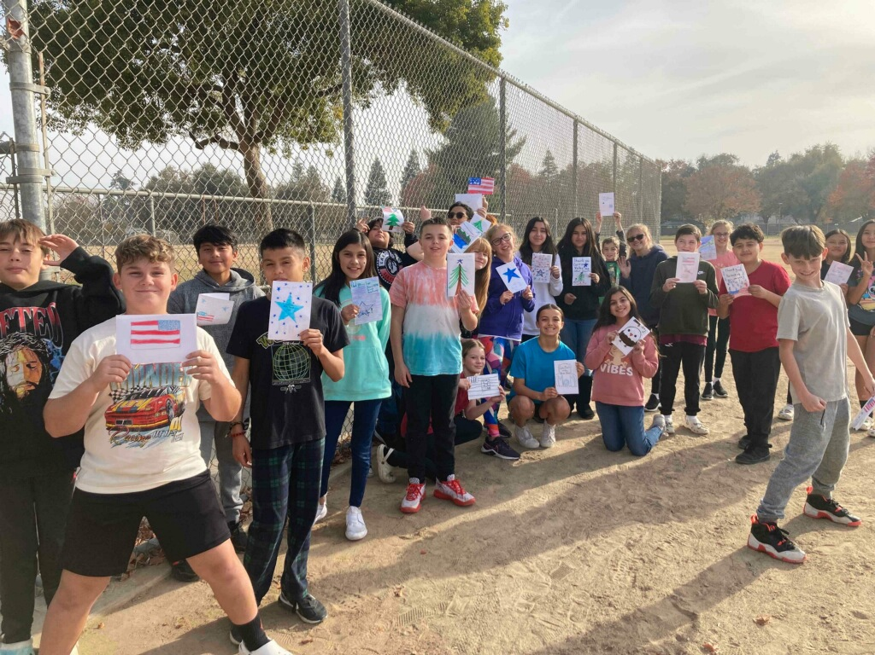
Photo Gallery
Photo of military service members opening care packages sent to them by the Central Valley Blue Star Moms.
Picture of Mr. Pfitzer’s 6th grade class holding
their notes written for the Blue Star Moms.

Slide 6
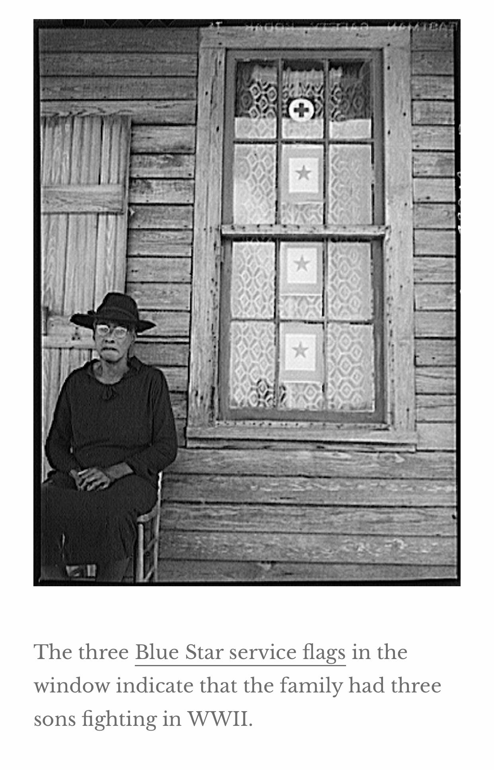
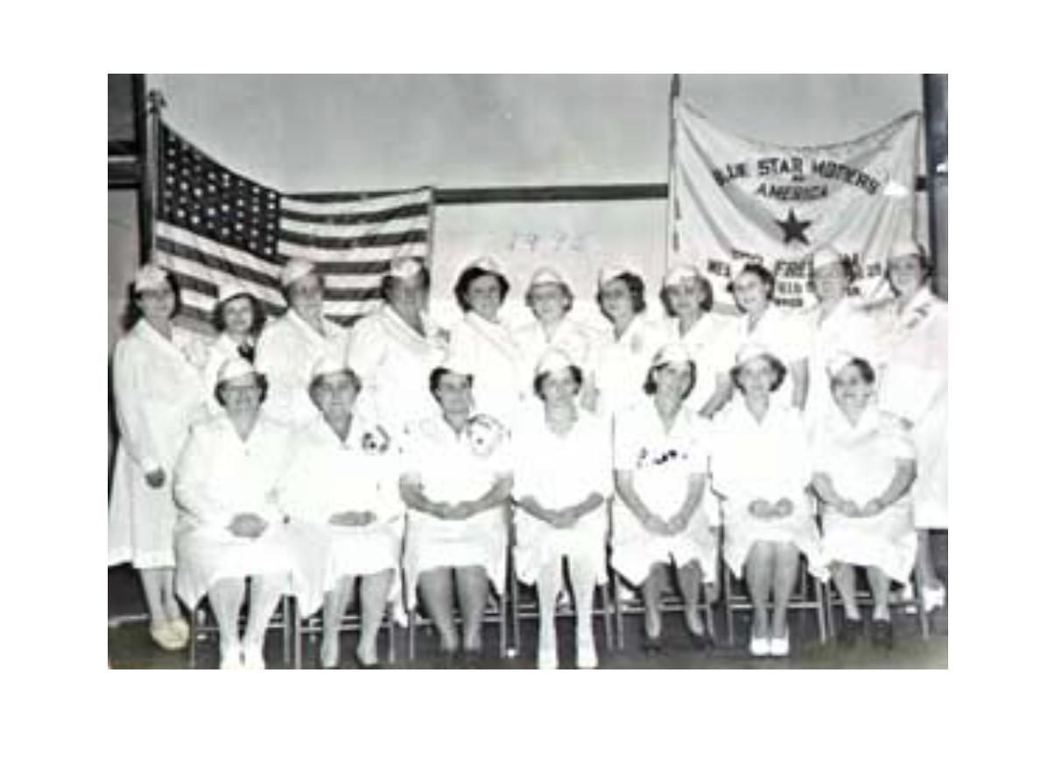
Photo Gallery Cont.
This picture displays an early Blue Star Mom in front of her home; there are 3 stars in her window representing her 3 children in the military.
Photograph of a portion of the women who were a part of the first meeting of the Blue Star Moms.

